Slide 1
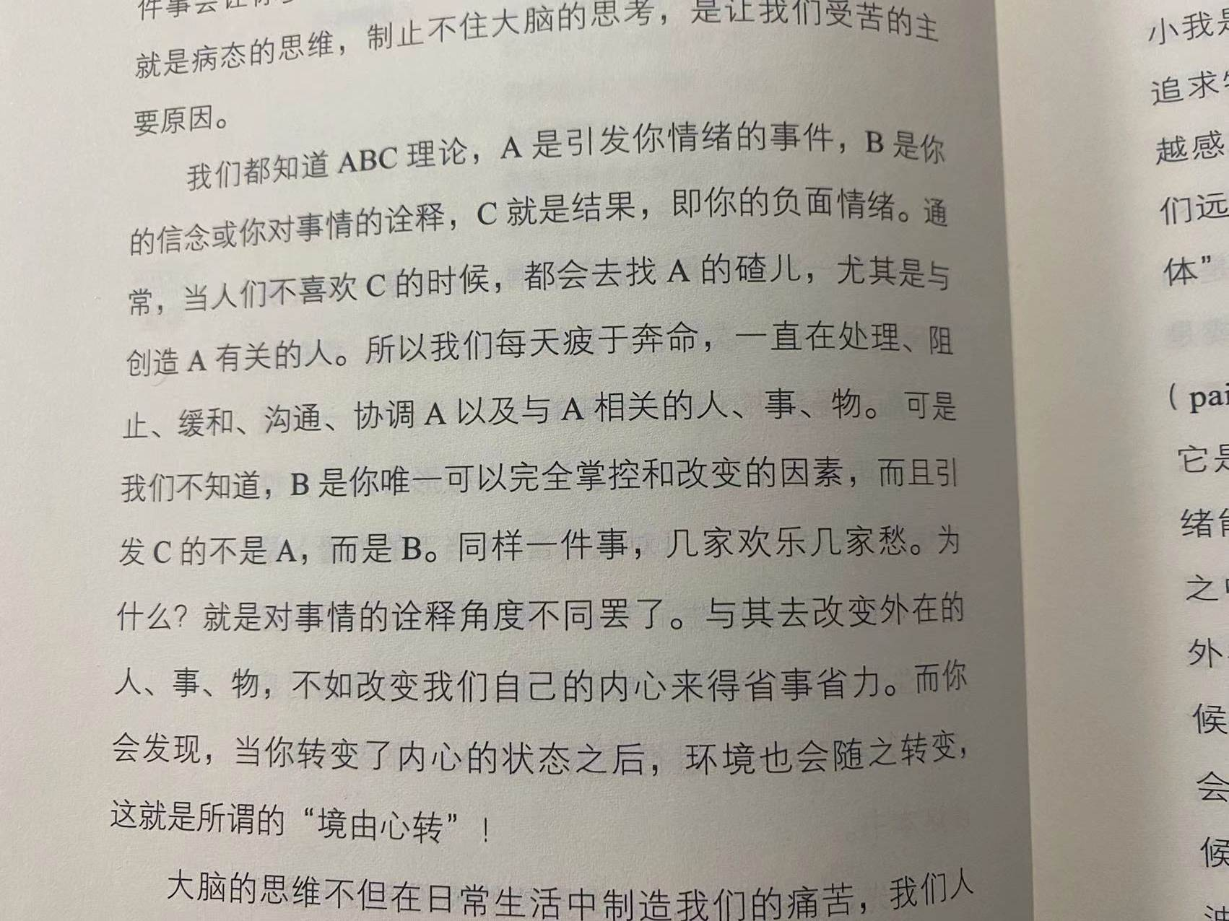

Slide 2
Chapter 8 Advanced Counting Techniques
8.1 Recurrence Relations
8.2 Solving Linear Recurrence Relations
8.4 Generating Functions
8.5 Inclusion-Exclusion
8.6 Applications of Inclusion-Exclusion

Slide 3
8.6 Applications of Inclusion-Exclusion
Homework: April 29
Sec. 8.4 6(d,f), 10 (c, d, e), 16, 24(a), 32, 36, 45
8th
Homework: April 29
Sec. 8.5 7, 10, 20
Sec. 8.6 6, 11, 16
8th
Homework:
Sec. 8.5 7, 10, 18
Sec. 8.6 6, 11, 16
7th

Slide 4
8.4 Generating Functions
Generating functions are useful for manipulating sequences.
  It can be used to solve many kinds of counting problems, such as
    -- The problem of combination and permutation with constraints
    -- The number of ways to make change for a dollar using coins of different denominations
  Solve recurrence relations
  Prove the combinatorial identities

Slide 5

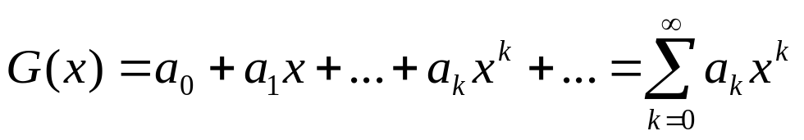
8.4 Generating Functions
1. Generating function for a sequence
【Definition 1】 The generating function for the sequence
of real numbers is the infinite series
A generating function is a clothesline on which we hang up a sequence of numbers for display.
  — Herbert Wilf, Generatingfunctionology (1994)

Slide 6
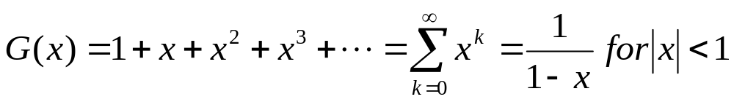
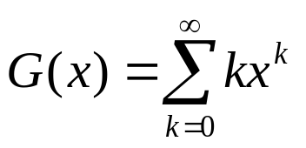
8.4 Generating Functions
〖Example 1〗
What is the generating function for the sequence
1, 1, 1, 1, ...?
(2) What is the generating function for the sequence 0, 1, 2, 3, 4, 5, ...?

Slide 7
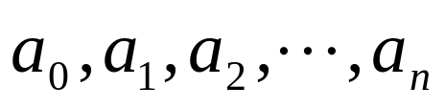

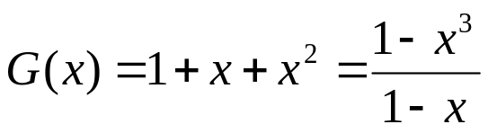

8.4 Generating Functions
The generating function for a finite sequence of real numbers
is
〖Example 2〗
The finite sequence: 1,1,1. The generating function for this sequence is
(2) Let . The generating function for this sequence is

Slide 8
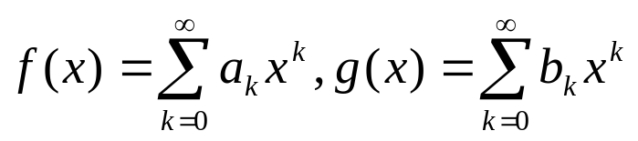
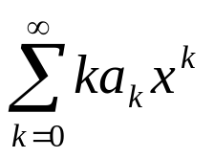
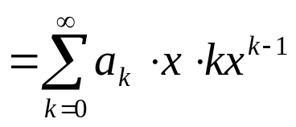
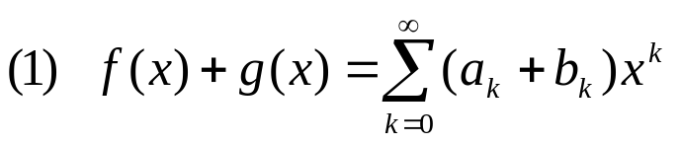
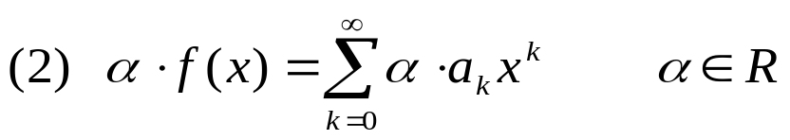
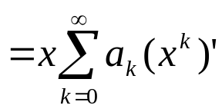
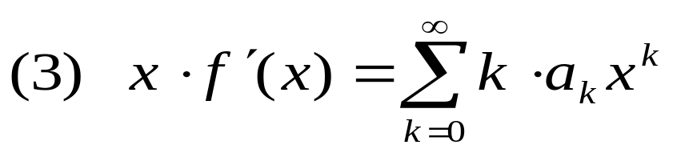
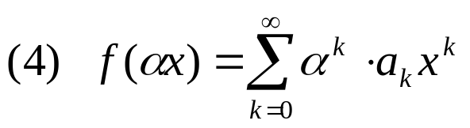
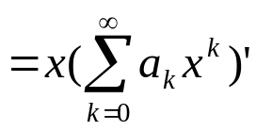
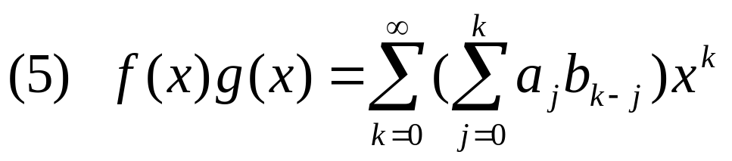

8.4 Generating Functions
2. Useful Facts About Power Series
【Theorem 1】Let . Then
Proof:

Slide 9
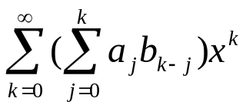
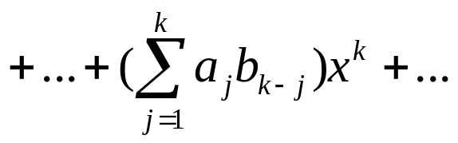

8.4 Generating Functions
2. Useful Facts About Power Series
Proof:
Let . Then

Slide 10
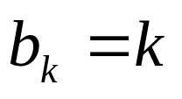
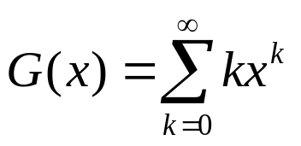
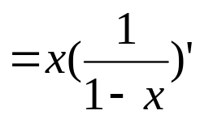
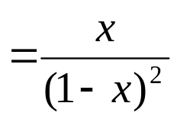
8.4 Generating Functions
Using the above properties, the generating functions of some sequences can be obtained easily.
〖Example 3〗 (1) What is the generating function for the sequence 0,1,2,3,4,5,…?
Solution:

Slide 11
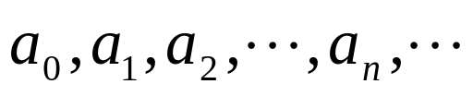
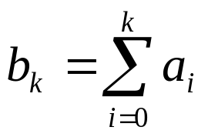

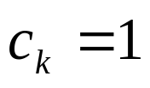
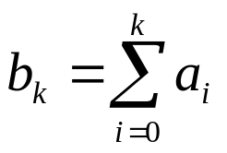
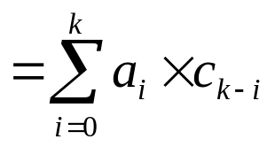
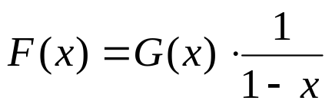
8.4 Generating Functions
〖Example 3〗 (2) Suppose that the generating function of the sequence: is G(x). What is the generating function for the sequence ?
Solution:

Slide 12
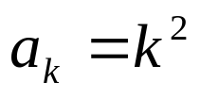
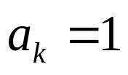
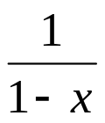
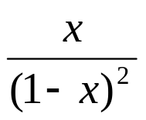
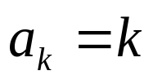
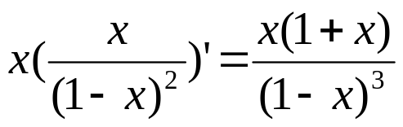
8.4 Generating Functions
〖Example 3〗 (3) What is the generating function for the sequence ?
Solution:

Slide 13
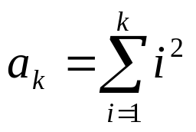
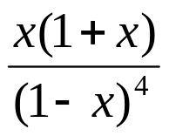
8.4 Generating Functions
〖Example 3〗 (4) What is the generating function for the sequence ?
Solution:

Slide 14
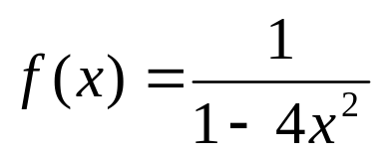
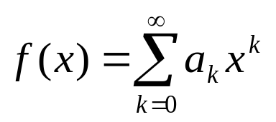
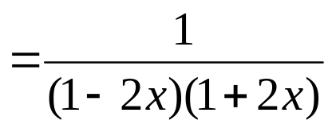
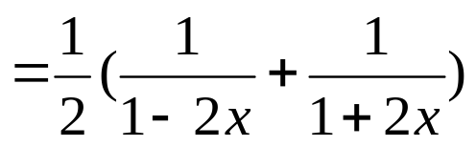

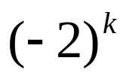
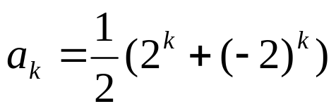
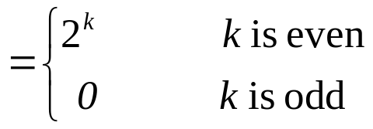
8.4 Generating Functions
〖Example 4〗 Let . Find the coefficient
in the expansion .
Solution:

Slide 15
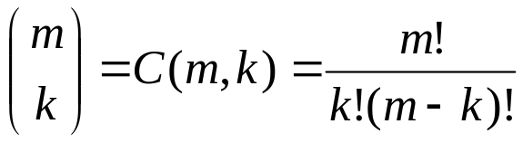
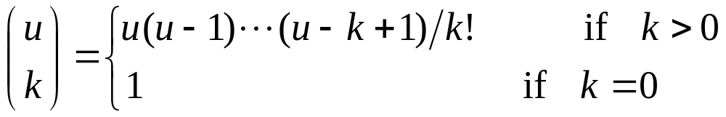
8.4 Generating Functions
The extended binomial coefficient
Recall:
  Where m, k are nonnegative integers, k≤m
【Definition 2】 Let u be a real number and k a nonnegative integer. Then the extended binomial coefficient is defined by

Slide 16
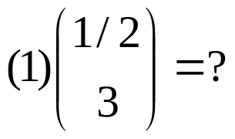
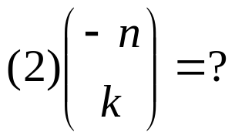
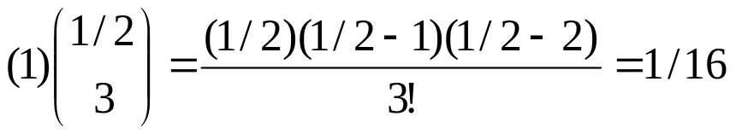
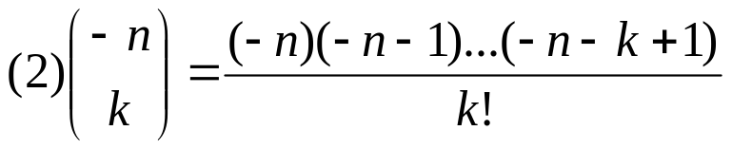
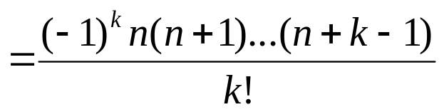

8.4 Generating Functions
〖Example 5〗
Solution:

Slide 17


8.4 Generating Functions
The extended Binomial Theorem
【 Theorem 2】Let x be a real number with and let u be
a real number. Then

Slide 18








8.4 Generating Functions
〖Example 6〗Find the generating functions for
where n is a positive integer, using the extended Binomial Theorem.
Solution:
By the extended Binomial Theorem , it follows that

Slide 19












8.4 Generating Functions
3. Some Common Used Generating Functions
Sequence Generating function

Slide 20










8.4 Generating Functions
3. Some Common Used Generating Functions
Sequence Generating function

Slide 21
8.4 Generating Functions
4. Counting with Generating Functions
Generating functions can be used to solve a wide variety of counting problems, such as
Count the number of combinations from a set when repetition is allowed and additional constraints exist.
Count the number of permutations

Slide 22


OLD- 6.5 Generalized Permutations and Combinations
〖Example 7〗How many solutions are there to the equation
where is nonnegative integer?
Solution:
Since a solution of this equation corresponds to a way of
selecting 16 items from a set with four elements so that x₁
items of type one, x₂ items of type two, x₃ items of type three,
x₄ items of type four are chosen.
Hence the number of solutions is
C (4-1+16, 16) = C (19, 16)
= C (19, 3)

Slide 23


OLD-6.5 Generalized Permutations and Combinations
〖Example 7〗How many solutions are there to the equation
where is nonnegative integer?
Question:
x_{i}≥2
(1)
C (4-1+8, 8) = C (11, 8) = C (11, 3)
(2)
We can introduce an auxiliary variable x₅ so that
x₁ + x₂ + x₃+ x₄ +x₅ =16
C (5-1+16, 16) = C (20, 16) = C (20, 4)

Slide 24


8.4 Generating Functions
〖Example 7〗Use generating functions to find the number of r-combinations from a set with n elements with repetitions allowed.
Solution:
Since there are n elements in the set, each can be selected zero times, one times and so on. It follows that
the number of r-combinations from a set with n elements with repetitions allowed, is the coefficient a_{r} of x^{r} in the expansion of G(x) . Since
Then the coefficient a_{r} equals C (n+r-1,r)

Slide 25



8.4 Generating Functions
〖Example 8〗Find the number of solutions of where are nonnegative integers with
.
Solution:
The generating function for this counting problem is
The number of solutions is the coefficient of x¹⁷ in the expansion of
G(x).

Slide 26








8.4 Generating Functions
〖Example 9〗Suppose that there are 2r red balls, 2r blue balls, and 2r white balls. How many ways to select 3r balls from these balls?
Solution:
How to find a_{3r} ?
The coefficient a_{3r} of x^{3r} in the expansion of G(x) is the solution of this problem.
The coefficient of term x^{i} in F(x) is
The coefficient of term x^{r-1} in F(x) is

Slide 27
8.4 Generating Functions
〖Example 10〗Determine the number of ways to insert tokens worth $1,$2 and $5 into a vending machine to pay for an item that costs r dollars in both the cases when the order in which the tokens are inserted does not matter and when the order does matter.

Slide 28


8.4 Generating Functions
Solution:
(1) The order in which the tokens are inserted does not matter
The coefficient of x^{r} in the expansion of G(x) is the solution of this problem.
(2) The order in which the tokens are inserted does matter
The number of ways to insert exactly n tokens to produce a
total of r$ is the coefficient of x^{r} in
Since any number of tokens may be inserted, the number
of ways to produce r$ using $1,$2 and $5 tokens, is the
coefficient of x^{r} in

Slide 29

8.4 Generating Functions
5. Using Generating Functions to Solve Recurrence Relations
The Methods of Solving Recurrence Relations
  Iterative approach
  Use a systematic way to solve an important class of recurrence relations
  Generating functions
Method:
(1) Use the recurrence relation
to find the generating
function of this sequence;
(2)

Slide 30












8.4 Generating Functions
〖Example 11〗 Use generating functions to solve the recurrence relation with initial conditions .
Solution:

Slide 31








8.4 Generating Functions

Slide 32
8.4 Generating Functions
6. Proving Identities via Generating Functions
The method of proving combinatorial identities:
  Use combinatorial proofs
  Use generating functions

Slide 33

8.4 Generating Functions
〖Example 12〗 Use generating functions to prove Pascal’s identity when n and r are positive integers with .

Slide 34






8.4 Generating Functions
Proof:

Slide 35
Homework: April 29
Sec. 8.4 6(d,f), 10 (c, d, e), 16, 24(a), 32, 36, 45
8th

Slide 36
Chapter 8 Advanced Counting Techniques
8.1 Recurrence Relations
8.2 Solving Linear Recurrence Relations
8.4 Generating Functions
8.5 Inclusion-Exclusion
8.6 Applications of Inclusion-Exclusion

Slide 37

8.5 Inclusion-exclusion
Recall:
The principle of Inclusion-exclusion
mathematical induction
Show that an element in the union is counted exactly once by the right-hand side of the equation
For the union of three finite sets:
For the union of n finite sets:

Slide 38






8.5 Inclusion-exclusion
Proof:
Suppose that a is an element of exactly r sets of the sets
where .
This element is counted times by .
This element is counted times by .
…
Thus, it is counted exactly
= 1
Why ?
Since (-1+1)^{r}=0

Slide 39
8.5 Inclusion-exclusion
〖Example 1〗 Suppose that there are 1807 freshmen at your school. Of these, 453 are taking a course in computer science, 567 are taking a course in mathematics, and 299 are taking courses in both computer science and mathematics. How many are not taking a course either in computer science or in mathematics?
|U|=1807
A
A∩B B
|A|=453
|B|=567
| A∩B |=299

Slide 40



8.5 Inclusion-exclusion
〖Example 2〗How many positive integers not exceeding 1000 that are not divisible by 5, 6 or 8?
Solution:
U: the set of positive integers not exceeding 1000
A: the set of positive integers not exceeding 1000 that are divisible by 5,
B: the set of positive integers not exceeding 1000 that are divisible by 6,
C: the set of positive integers not exceeding 1000 that are divisible by 8.

Slide 41

8.5 Inclusion-exclusion
〖Example 3〗How many permutations of the 26 letters of the English alphabet do not contain any of the strings fish, rat or bird?
Solution:
U: the set of permutations of the 26 letters
A: the set of permutations of the 26 letters containing fish,
B: the set of permutations of the 26 letters containing rat,
C: the set of permutations of the 26 letters containing bird.

Slide 42
Chapter 8 Advanced Counting Techniques
8.1 Recurrence Relations
8.2 Solving Linear Recurrence Relations
8.4 Generating Functions
8.5 Inclusion-Exclusion
8.6 Applications of Inclusion-Exclusion

Slide 43





8.6 Applications of Inclusion-Exclusion
1. An alternative form of inclusion-exclusion
Problems that ask for the number of elements in a set that have none of n properties
.
Let be the subset containing the elements that have property .
----The number of elements with none of the properties .
From the inclusion-exclusion principle, we see that

Slide 44














8.6 Applications of Inclusion-Exclusion
〖Example 1〗How many solutions does have, where are nonnegative integers with ?
Solution:
Let a solution have property is , property is , property is .
The number of solutions is

Slide 45
8.6 Applications of Inclusion-Exclusion
2. The sieve of Eratosthenes (埃拉托色尼筛)
〖Example 2〗Find the number of primes not exceeding a specified positive integer.
Take 100 for example.
Solution:
A composite integer is divisible by a prime not exceeding
its square root.
Composite integer not exceeding 100 must have a prime
factor not exceeding 10.
Since the only primes less than 10 are 2,3,5,7, the primes
not exceeding 100 are these four primes and the positive
integers greater than 1 and not exceeding 100 that are
divisible by none of 2,3,5,7.

Slide 46


8.6 Applications of Inclusion-Exclusion
P₁: the property that an integer is divisible by 2
P₂: the property that an integer is divisible by 3
P₃: the property that an integer is divisible by 5
P₄: the property that an integer is divisible by 7
The number of primes not exceeding positive integer 100 is
⎣100/2⎦
⎣100/(2×3)⎦
99
⎣100/(2×3 ×5)⎦
⎣100/(2×3 ×5 ×7)⎦

Slide 47
8.6 Applications of Inclusion-Exclusion
The sieve of Eratoshenes -1
1 2 3 4 5 6 7 8 9 10
11 12 13 14 15 16 17 18 19 20
21 22 23 24 25 26 27 28 29 30
31 32 33 34 35 36 37 38 39 40
41 42 43 44 45 46 47 48 49 50
51 52 53 54 55 56 57 58 59 60
61 62 63 64 65 66 67 68 69 70
71 72 73 74 75 76 77 78 79 80
81 82 83 84 85 86 87 88 89 90
91 92 93 94 95 96 97 98 99 100

Slide 48
8.6 Applications of Inclusion-Exclusion
The sieve of Eratoshenes -1
1 2 3 4 5 6 7 8 9 10
11 12 13 14 15 16 17 18 19 20
21 22 23 24 25 26 27 28 29 30
31 32 33 34 35 36 37 38 39 40
41 42 43 44 45 46 47 48 49 50
51 52 53 54 55 56 57 58 59 60
61 62 63 64 65 66 67 68 69 70
71 72 73 74 75 76 77 78 79 80
81 82 83 84 85 86 87 88 89 90
91 92 93 94 95 96 97 98 99 100

Slide 49
8.6 Applications of Inclusion-Exclusion
The sieve of Eratoshenes -1
1 2 3 4 5 6 7 8 9 10
11 12 13 14 15 16 17 18 19 20
21 22 23 24 25 26 27 28 29 30
31 32 33 34 35 36 37 38 39 40
41 42 43 44 45 46 47 48 49 50
51 52 53 54 55 56 57 58 59 60
61 62 63 64 65 66 67 68 69 70
71 72 73 74 75 76 77 78 79 80
81 82 83 84 85 86 87 88 89 90
91 92 93 94 95 96 97 98 99 100

Slide 50
8.6 Applications of Inclusion-Exclusion
The sieve of Eratoshenes -1
1 2 3 4 5 6 7 8 9 10
11 12 13 14 15 16 17 18 19 20
21 22 23 24 25 26 27 28 29 30
31 32 33 34 35 36 37 38 39 40
41 42 43 44 45 46 47 48 49 50
51 52 53 54 55 56 57 58 59 60
61 62 63 64 65 66 67 68 69 70
71 72 73 74 75 76 77 78 79 80
81 82 83 84 85 86 87 88 89 90
91 92 93 94 95 96 97 98 99 100

Slide 51
8.6 Applications of Inclusion-Exclusion
The sieve of Eratoshenes -1
1 2 3 4 5 6 7 8 9 10
11 12 13 14 15 16 17 18 19 20
21 22 23 24 25 26 27 28 29 30
31 32 33 34 35 36 37 38 39 40
41 42 43 44 45 46 47 48 49 50
51 52 53 54 55 56 57 58 59 60
61 62 63 64 65 66 67 68 69 70
71 72 73 74 75 76 77 78 79 80
81 82 83 84 85 86 87 88 89 90
91 92 93 94 95 96 97 98 99 100

Slide 52





8.6 Applications of Inclusion-Exclusion
3. The number of onto functions
Theorem:
Let m and n be positive integers with . Then, there are
onto functions from a set with m elements to a set with n
elements.
Proof:
Let be the property that is not in the range of the function, respectively.
Note that a function is onto if and only if it has none of the properties .

Slide 53




8.6 Applications of Inclusion-Exclusion
By the principle of inclusion-exclusion, it follows that the number of onto functions is
Applications:
  Assign m different jobs to n different employees if every employee is assigned at least one job.
  Distribute m different toys to n different children such that each child gets at least one toy.
  只要bi 不在即可计入

Slide 54
8.6 Applications of Inclusion-Exclusion
4. Derangement
〖Example 3〗Count the permutations for n objects that leave no objects in their original positions.
A derangement is a permutation of objects that leaves no object in its original position.

Slide 55




Let a permutation have property P_{i} if it fixes element i.
Theorem: The number of derangements of a set with n elements is
A derangement is a permutation of objects that leaves no object in its original position.
Proof:
The number of derangements is the number of permutations having none of the properties P_{i} for i=1, 2, …, n.

Slide 56


Derangements (continued)
The Hatcheck Problem: A new employee checks the hats of n people at restaurant, forgetting to put claim check numbers on the hats. When customers return for their hats, the checker gives them back hats chosen at random from the remaining hats. What is the probability that no one receives the correct hat.
Solution: The answer is the number of ways the hats can be arranged so that there is no hat in its original position divided by n!, the number of permutations of n hats.
Remark: It can be shown that the probability of a derangement approaches 1/e as n grows without bound.

Slide 57
8.6 Applications of Inclusion-Exclusion
Homework: April 29
Sec. 8.5 7, 10, 20
Sec. 8.6 6, 11, 16
8th
Homework:
Sec. 8.5 7, 10, 18
Sec. 8.6 6, 11, 16
7th

